Slide 1


Abbott Guidelines
Updating Remittance Address and
Invoicing

Slide 2
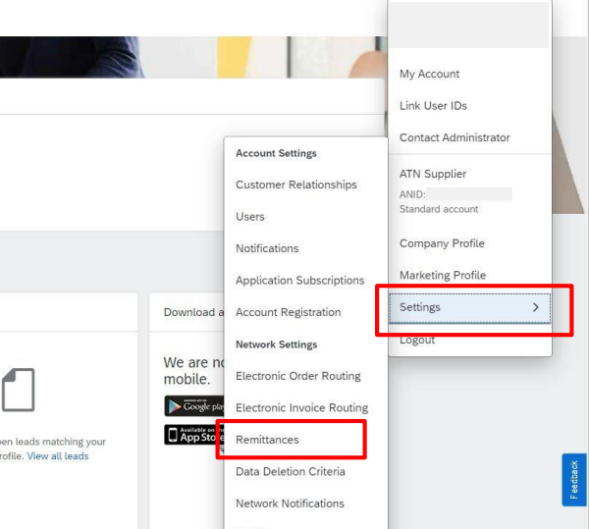
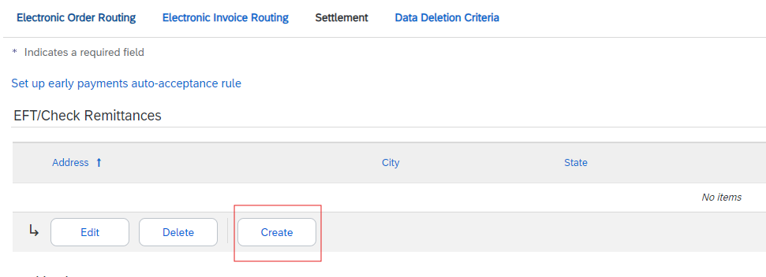
Add or change your Remit to address in your Ariba Portal
It’s very important that your remit to address in your invoice, is the same one you have on your PO, or was previously sent to us via form in your Abbott registration questionnaire – in case you have several remit to address. Any mismatches will lead to invoice rejection – Please follow the instructions below if the address on the invoice is not matching the PO.
Sign in to your SAP Business Network account.
In the upper-right corner of the application, click [user initials] > Settings.
Click Remittances.
In the EFT/Check Remittance section, click Create to create a new remittance address. To edit an existing remittance address, select it from the list and click Edit

Slide 3
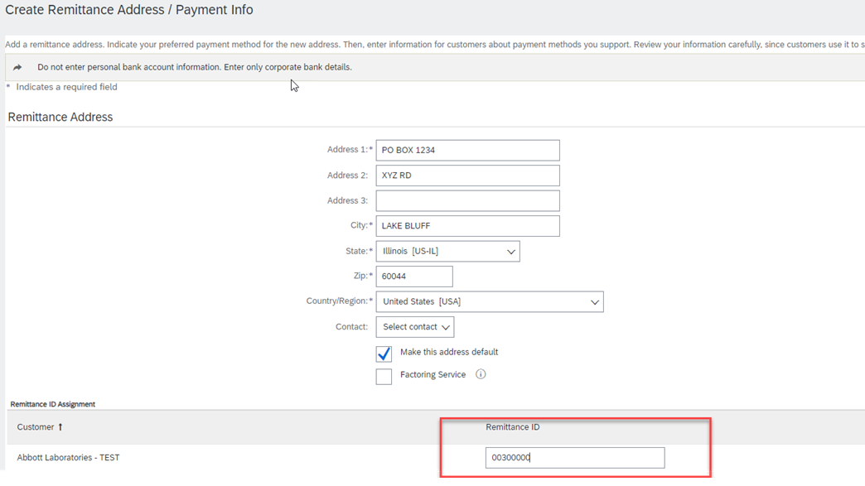
Add or change your Remit to address in your Ariba Portal
If Abbott is not listed as your customer, please contact Ariba@abbott.com
Do not Select any contact – keep it always as “Select Contact”
Enter Remittance ID provided by Abbott if you have more than one Remit to Address

Slide 4
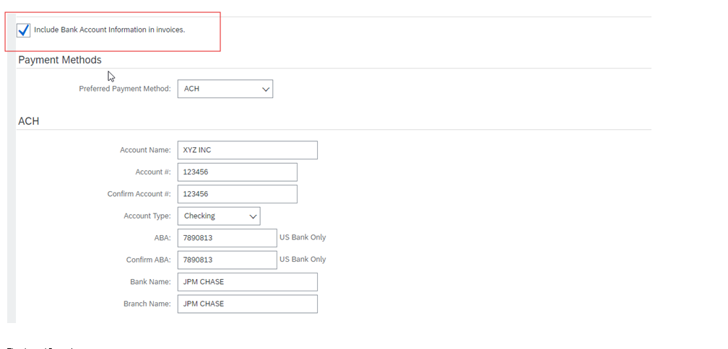
To include your remittance information in your invoices, you may:
Tick the box to the left of Include Bank Account Information in invoices.
Click OK at the top or bottom of the page.
Click Save.
Notes:
Note: When including the banking on the invoice- this will help expedite processing time.

Slide 5
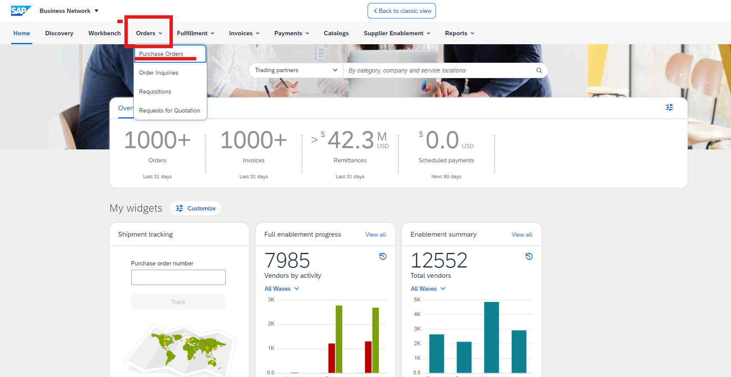
Access the PO in the SAP Business Network
2. Select Purchase orders
1. Go to orders tab
Notes:
Start with the screen they see when they first log in-

Slide 6
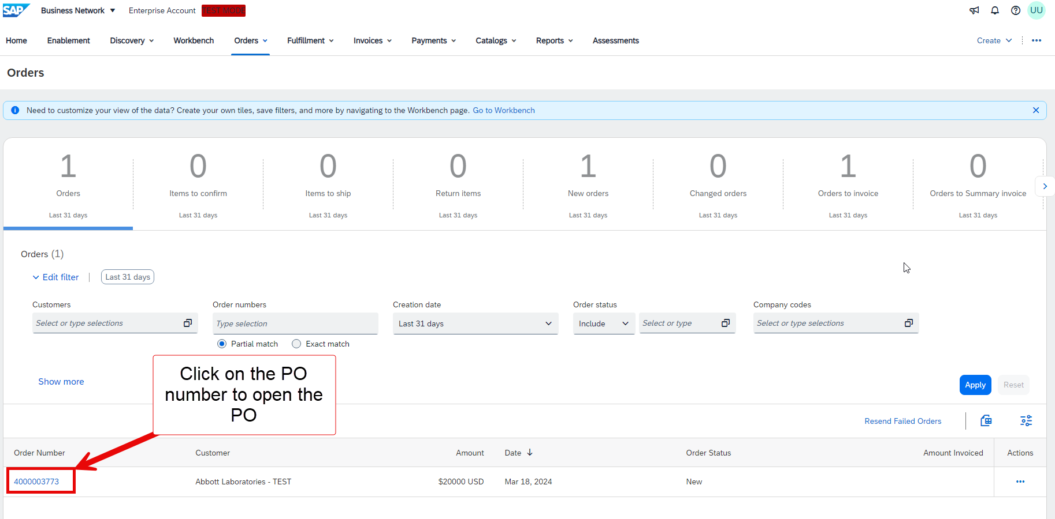
Access the PO in the SAP Business Network
Make sure your filters are set up accordingly – If PO is older than 31 days, you need to select another time range
Notes:
Start with the screen they see when they first log in-

Slide 7
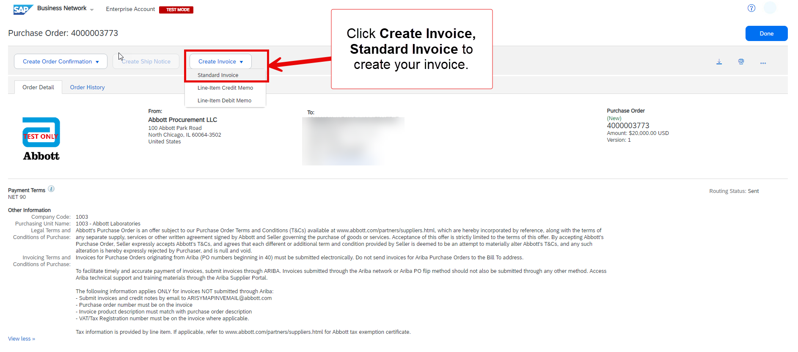
Access the PO in the SAP Business Network

Slide 8
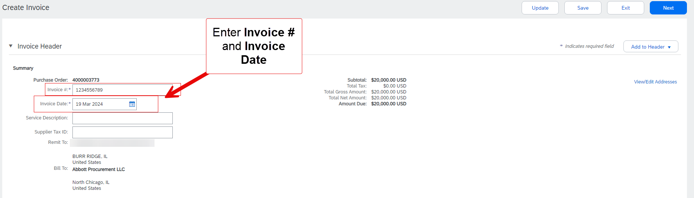
Create the Invoice

Slide 9
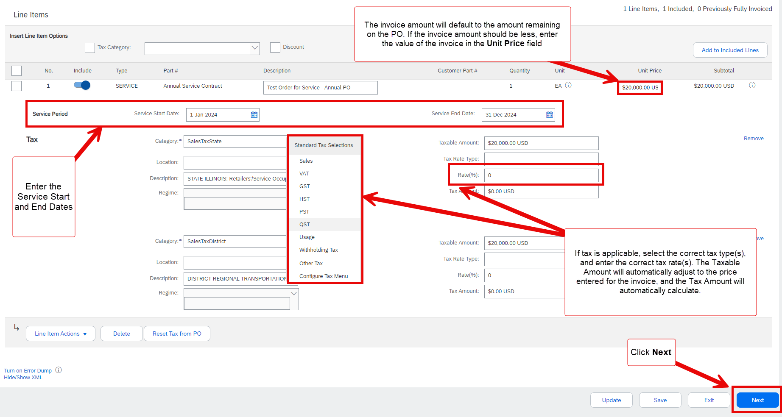
Create the Invoice

Slide 10
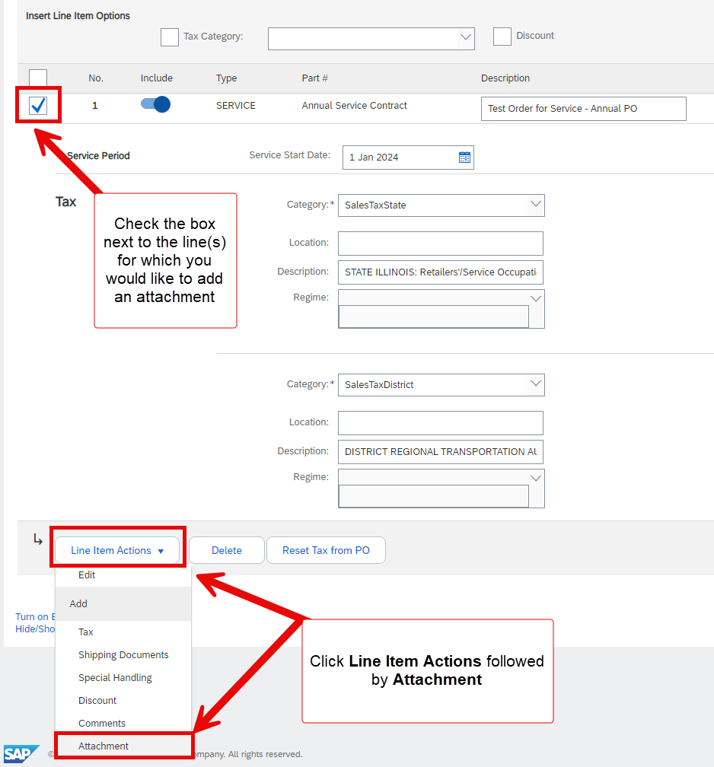
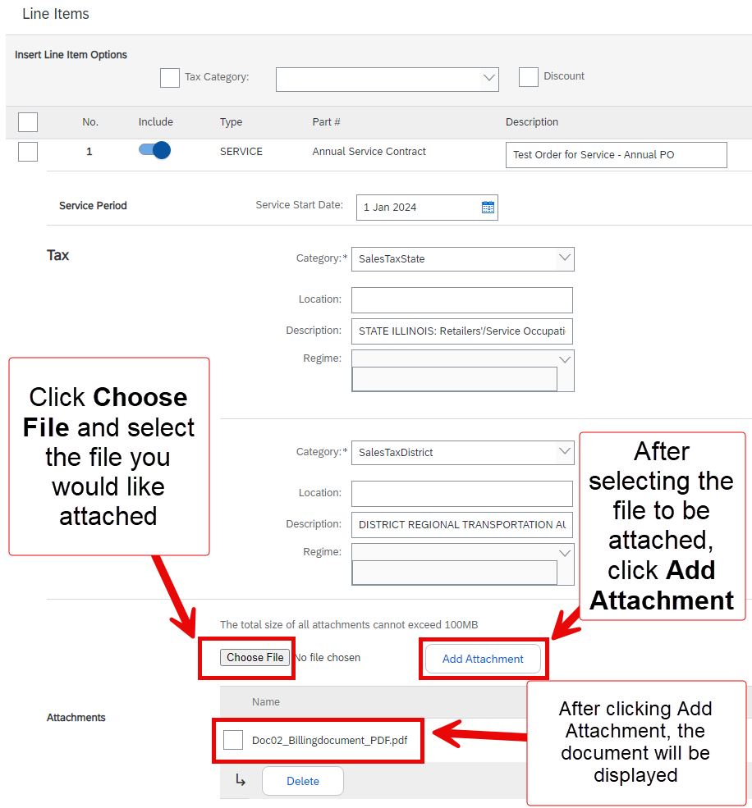
Create the Invoice (Attaching additional documents)

Slide 11
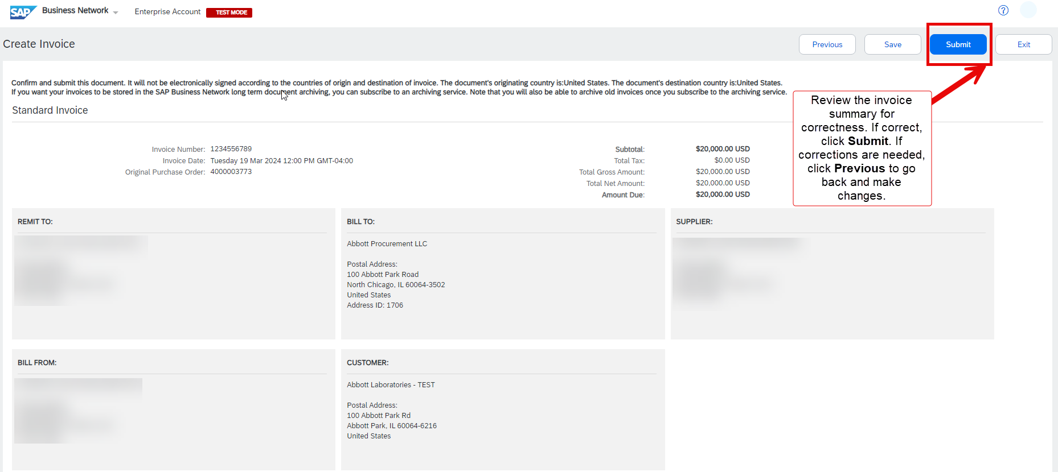
Submit the Invoice

